Slide 1
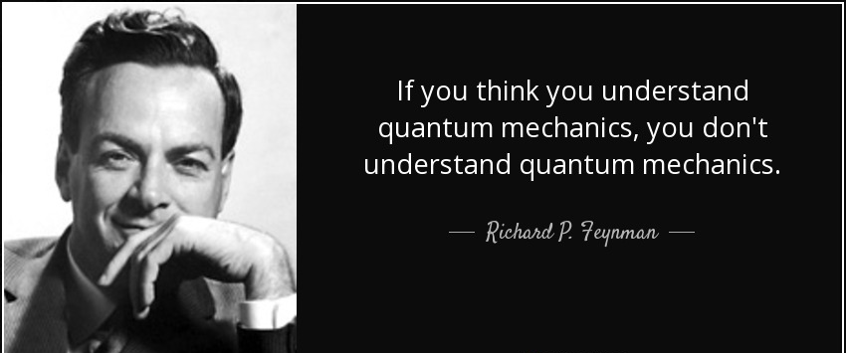

Slide 2


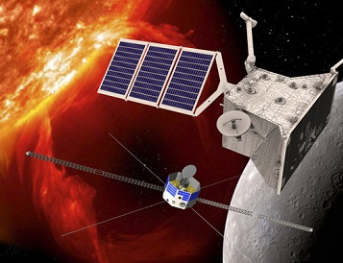
Computing Today
Processing Unit | Purpose | Function | Architecture | Parallelism | Examples
CPU (Central Processing Unit) | General-purpose computing | Executes various instructions and tasks | Optimized for single-threaded performance | Limited parallel processing capability | Intel Core, AMD Ryzen, and other consumer-grade processors
GPU (Graphics Processing Unit) | Originally graphics, now GPGPU | Well-suited for parallel tasks | Highly parallel architecture with thousands of cores | Excellent parallel processing capability | NVIDIA GeForce, AMD Radeon, and other consumer-grade GPUs
TPU (Tensor Processing Unit) | Accelerating machine learning (ML) | Optimized for ML tasks, especially neural networks | Designed for efficient matrix operations | Well-suited for parallel processing required in deep learning | Google's Cloud TPUs, Edge TPUs, and other ML accelerators

Slide 3
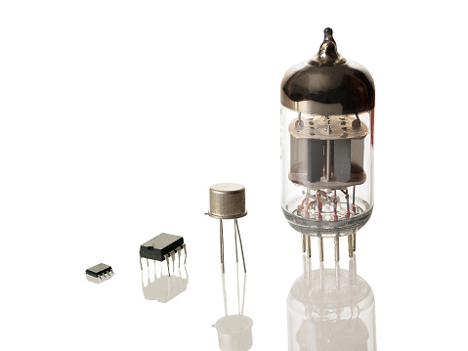
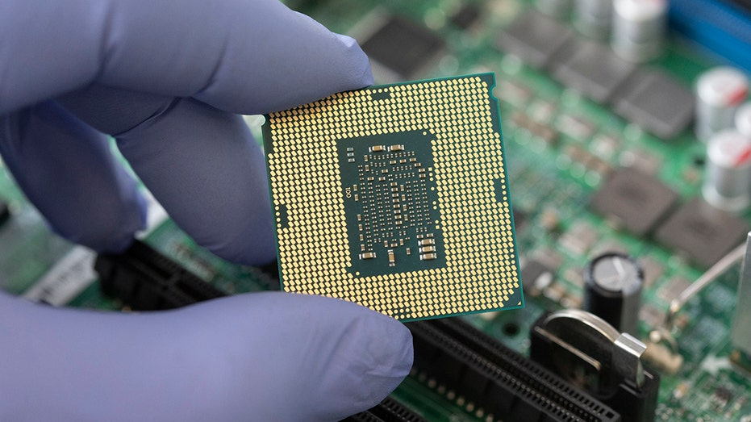

Computing Today
Worlds Smallest Microchip | IBM’s 2nm chip With 56 billion transistors Each transistor has size of 5 atoms.
World’s Largest Microchip | Cerebras WSE-2 With 2.6 trillion transistors, 46,225 square millimetres.

Slide 4
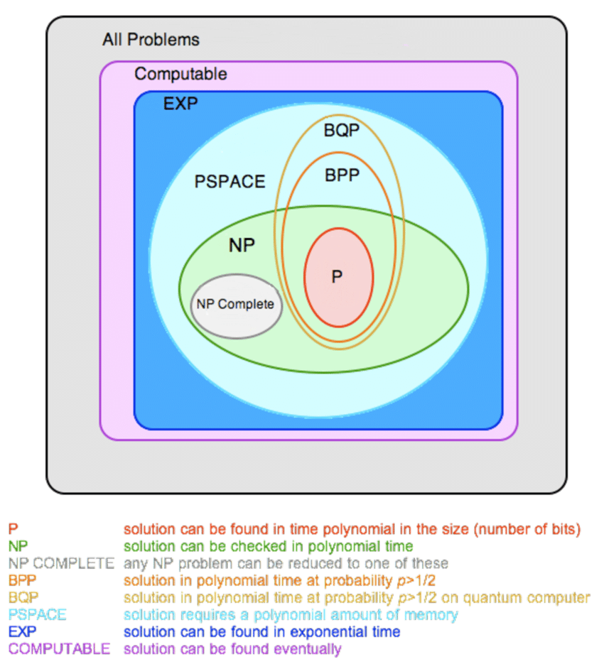

Intractable Problems – Still Exist!!

Slide 5

Quantum Algorithms and Applications
8th March 2025
PES University, Bangalore
Arthi Udayakumar
Tech Innovation Engineering Specialist
Accenture Labs, Bangalore

Slide 6
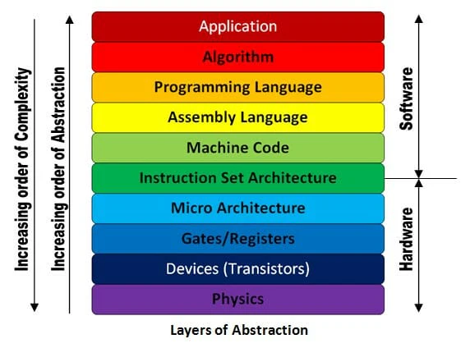
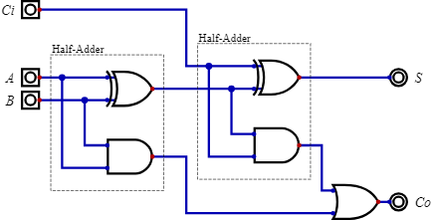
Classical Computer Architecture
Search algorithms are high-level procedures requiring comparisons, branching, and memory access.
The Arithmetic Logic Units (ALUs) are the fundamental unit of the essential operations (comparisons, address calculations) that search algorithms rely on.
Architecture of Classical Computer
Example ALU

Slide 7
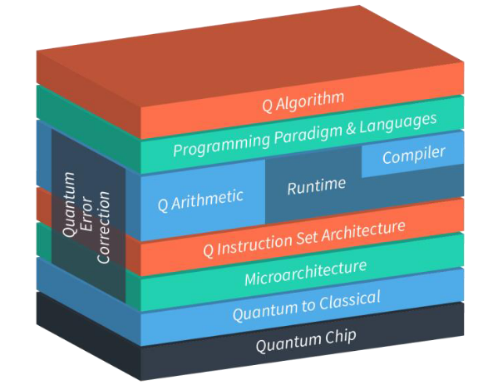
Quantum Computer Architecture
Applications - Software application-specific modules for natural science, optimization, machine learning, and finance
Applications
Algorithm - Quantum Serverless, Orchestration, Circuit Knitting
Kernel - Dynamic Circuits, Runtime primitives, Error suppression techniques
A simple Architecture of Quantum Computer

Slide 8
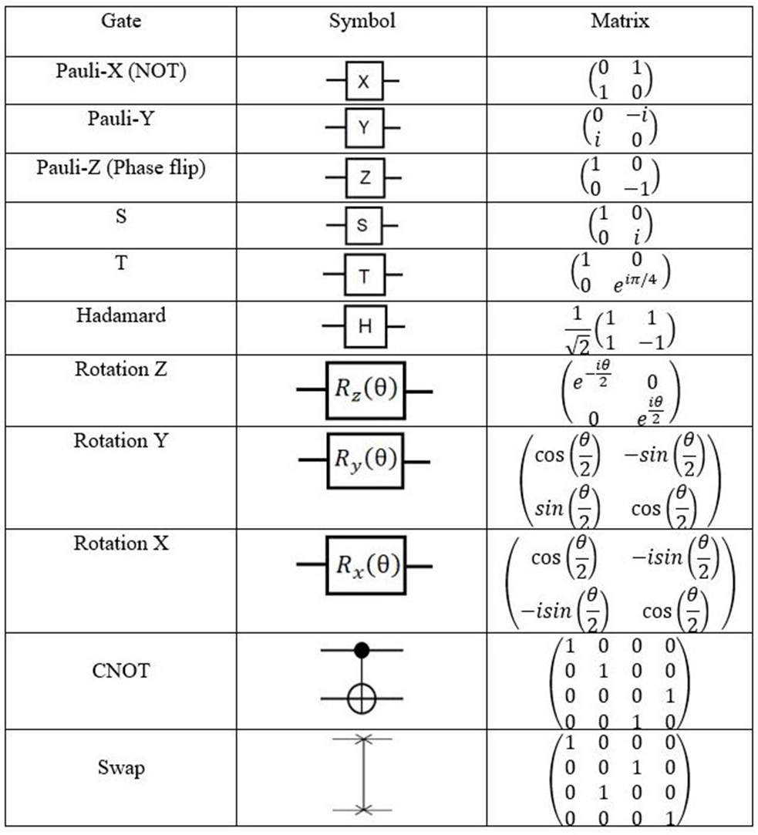
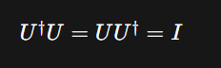
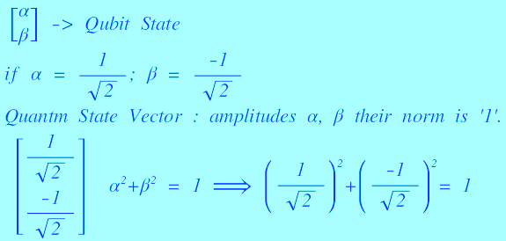
Quantum Gates
Quantum Gates: Are Matrices
Because Quantum States are vectors and to make Linear transformation we need matrices.
Quantum Gates : Are Unitary Matrix:
Unitary matrices preserve the norm (magnitude) of vectors, remain valid quantum states.

Slide 9
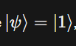
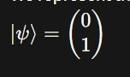
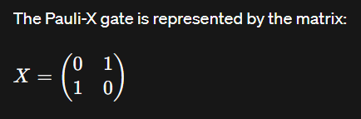

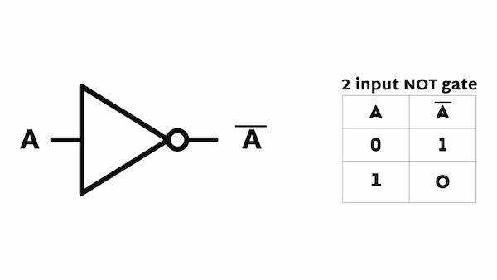
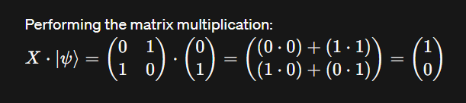
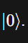
Quantum Circuit
Algorithm : Flip the input Values
Quantum
Classical
Given Quantum State:
ALU – NOT Operation
Apply X gate:

Slide 10
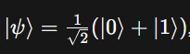
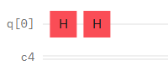
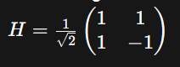
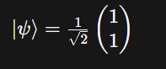
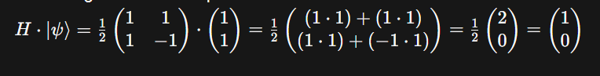
Quantum Circuit
Given Quantum State:
Apply Hadamard gate:
Notes:
Imagine you have two recipes, each calling for different ingredients like flour, sugar, and eggs. The dot product tells you how similar these recipes are in terms of these ingredients.
High dot product: Both recipes share many ingredients with similar quantities, indicating they are similar (e.g., both pancakes and cookies use flour and eggs).
Low dot product: The recipes use very different ingredients or quantities, indicating they are quite different (e.g., a cake recipe with lots of flour and sugar compared to a soup recipe with water and vegetables).

Slide 11

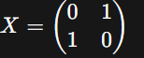
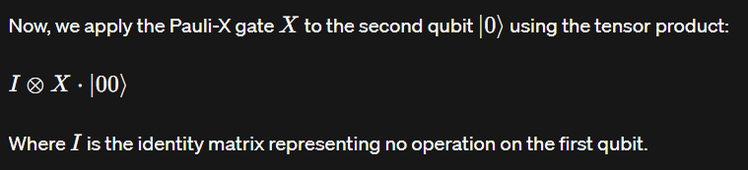
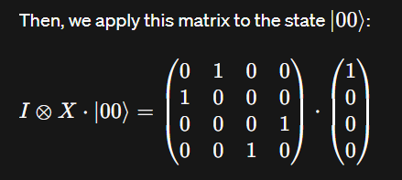
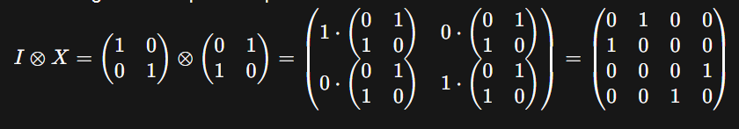
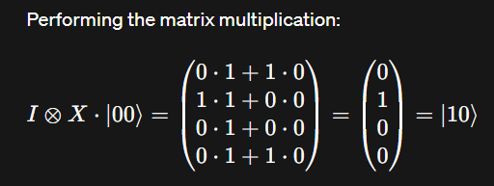
Quantum Circuit
Algorithm : Flip the second bit of the input
Given Quantum State:
Apply X gate only for Second qubit:
Notes:
Imagine you have two recipes, each calling for different ingredients like flour, sugar, and eggs. The dot product tells you how similar these recipes are in terms of these ingredients.
High dot product: Both recipes share many ingredients with similar quantities, indicating they are similar (e.g., both pancakes and cookies use flour and eggs).
Low dot product: The recipes use very different ingredients or quantities, indicating they are quite different (e.g., a cake recipe with lots of flour and sugar compared to a soup recipe with water and vegetables).

Slide 12
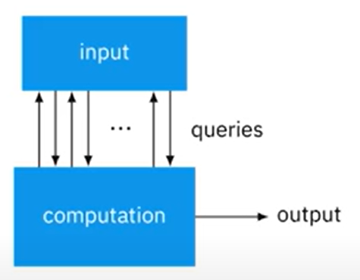
Algorithms
Query Algorithm
2 | 6 | 9 | 0 | 1 | 5 | 8
Suppose: It is a search algorithm: to find a ‘1’
5 Queries Needed
The computation is unknown or BlackBox
The efficiency is measured in the number of Queries required to get the required output.
Notes:
Imagine you have two recipes, each calling for different ingredients like flour, sugar, and eggs. The dot product tells you how similar these recipes are in terms of these ingredients.
High dot product: Both recipes share many ingredients with similar quantities, indicating they are similar (e.g., both pancakes and cookies use flour and eggs).
Low dot product: The recipes use very different ingredients or quantities, indicating they are quite different (e.g., a cake recipe with lots of flour and sugar compared to a soup recipe with water and vegetables).

Slide 13
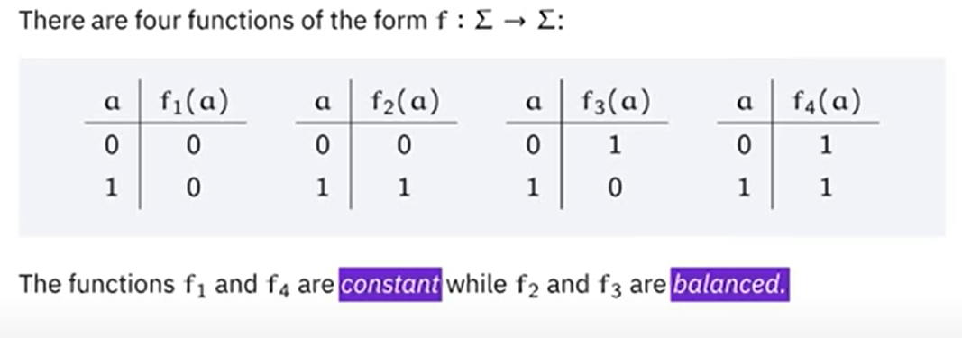
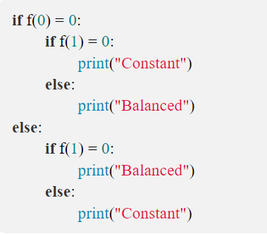
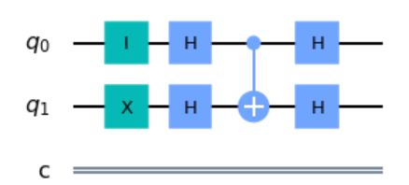
Quantum Algorithms
Query Algorithm
Deutsch algorithm
Input: One Digit
Output: One Digit
Quadratic speed up classical require 2 queries, but quantum do it in 1 query.
Input
Output

Slide 14
Quantum Algorithms
Query Algorithm
Input
Output
Quadratic speed up classical require 2 queries, but quantum do it in 1 query.
Deutsch algorithm
Superposition of Inputs - i.e both 0 and 1 input states computed in parallel.

Slide 15
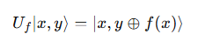
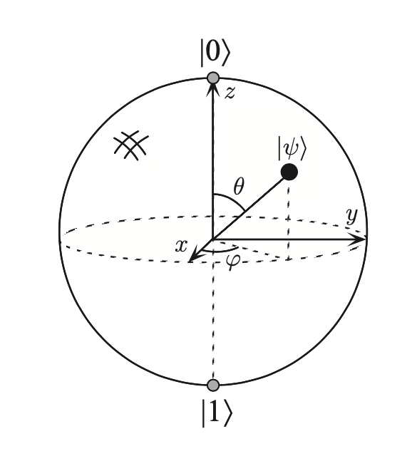
Quantum Algorithms
Query Algorithm
Input
Output
Quadratic speed up classical require 2 queries, but quantum do it in 1 query.
Deutsch algorithm
Oracle :
Unitary operator that represents the function f(x)
Phase kickback - a way to transfer information about a function from one qubit (input) to another qubit (output) by using quantum interference.
The input qubit is the "carrier" of the global property information.
The algorithm is designed to encode this information into the input qubit's phase.
The final Hadamard gate and measurement are used to extract this information from the input qubit function is constant or balanced.
Notes:
While the output qubit is essential for the oracle's operation, it doesn't directly carry the global property information in a way that allows for a single, straightforward measurement. Measuring the output qubit would give you information about f(0) or f(1), but not directly about whether the
The input qubit is the "carrier" of the global property information. The algorithm is designed to encode this information into the input qubit's phase. The final Hadamard gate and measurement are used to extract this information from the input qubit function is constant or balanced. The output qubit is more of an auxiliary qubit that enables the phase kickback operation.

Slide 16
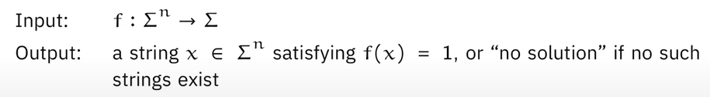

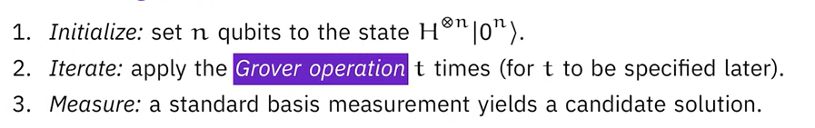
Quantum Algorithms
Grover’s Algorithm
Unstructured Search Problem
If , then evaluating each item in N with function f, requires N queries but Grover’s Algorithm require O(√ N) queries -→ it is Quadratic speedup.
Steps to do it in Quantum Grover’s Algorithm:

Slide 17
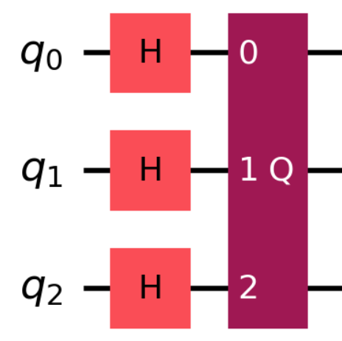
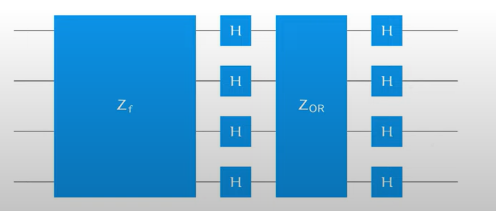
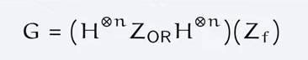
Quantum Algorithms
Grover’s Algorithm
Diffuser is a quantum operation that amplifies the amplitude of the marked item's state
Diffuser
G
Oracle
Quantum function that recognizes the marked item

Slide 18
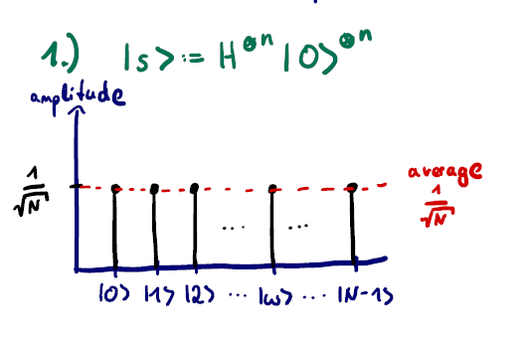
Quantum Algorithms
Grover’s Algorithm
Diffuser
G
Oracle

Slide 19
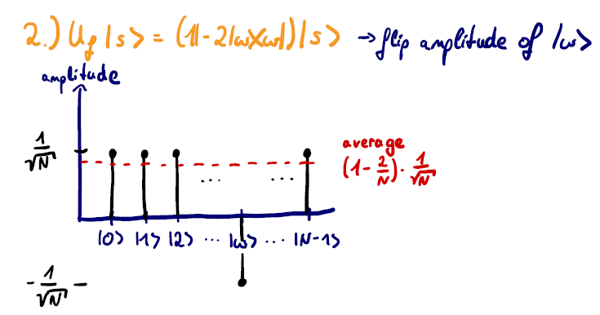
Quantum Algorithms
Grover’s Algorithm
Diffuser
G
Oracle
Zf .|s>

Slide 20
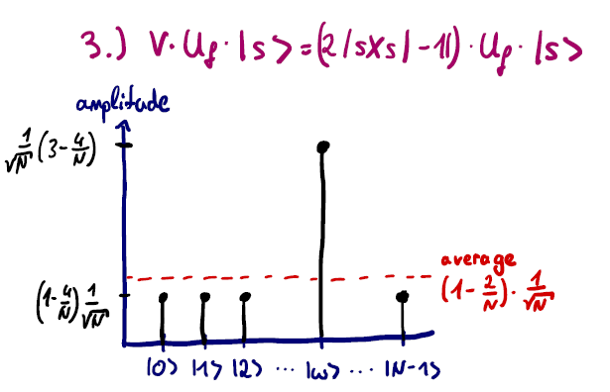
Quantum Algorithms
Grover’s Algorithm
V.Zf .|s>
Zf .|s>
Diffuser
G
Oracle
Zf .|s>

Slide 21
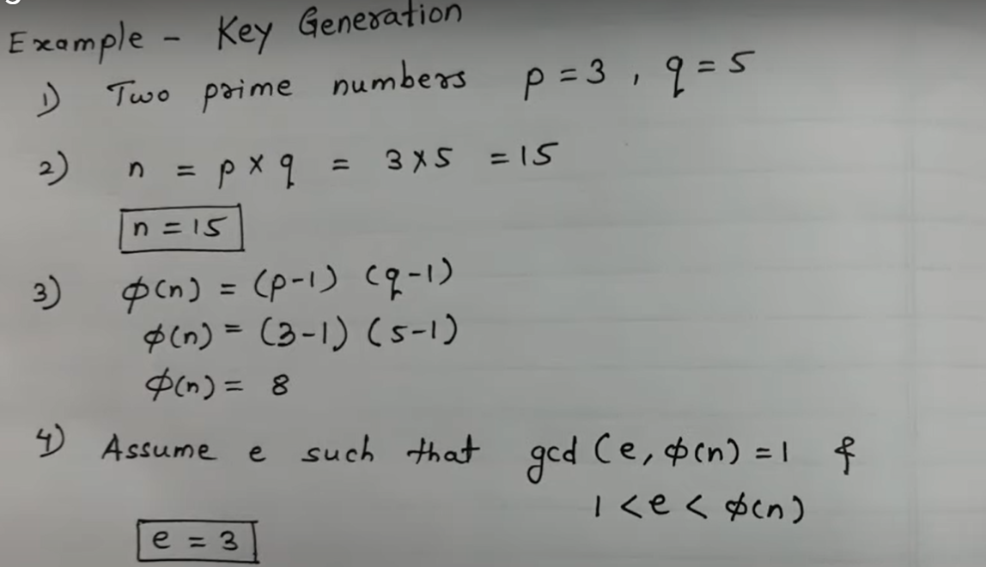
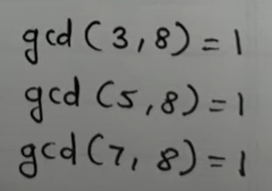
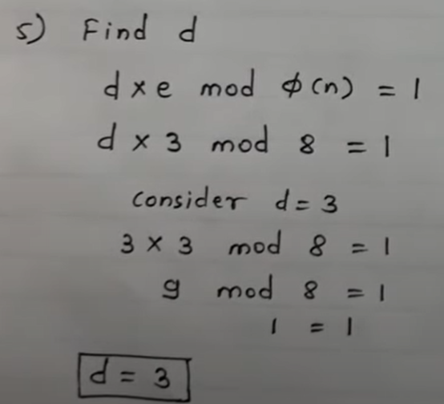
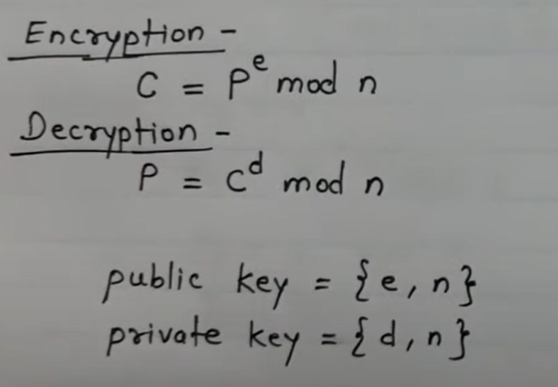
Algorithms
RSA Algorithm
Rivest Shamir Adleman
widely used public-key encryption system based
on the mathematical difficulty of factoring
large numbers.
P – Plain text
C- Cypher text

Slide 22

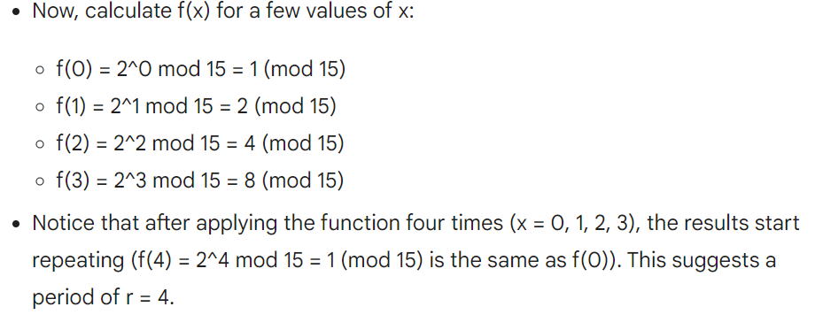
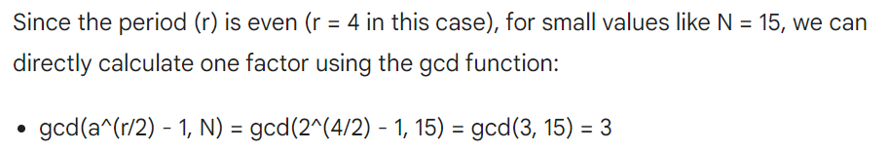
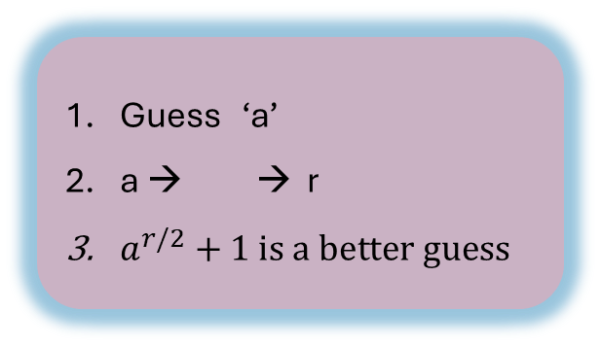
Quantum Algorithms
Shor’s Algorithm
Guess ‘a’
a → → r
$a^{r/2}+1 is a better guess$
Choose a random integer (a):
Let's pick a random integer a between 1 and n-1 (between 1 and 14 for n = 15).
Suppose we choose a = 2.
2. Period Finding (limited view for N = 15):
3. Deriving the Factors (limited view for N = 15):

Slide 23
Quantum Algorithms
Shor’s Algorithm - Period Finding
Quantum Fourier Transform
1. Quantum Fourier Transform (QFT):
Takes a quantum state as input.
Creates a superposition of all possible basis states.
Doesn't directly reveal a single peak frequency.
The amplitudes of the resulting state encode information about the original state. These amplitudes hold clues about the relative contributions of different basis states.
2. Quantum Phase Estimation (QPE):
Estimates the unknown phase shift of a quantum state manipulated within Shor's circuit.
Relies on QFT: It applies QFT to the manipulated state and analyzes the resulting amplitudes to extract phase information.
3. Shor's Algorithm:
Uses QPE as a subroutine to estimate the period of a specific function.
The concept of "frequency" in Shor's algorithm relates to the periodicity of the function's output.
By finding the period (p), Shor's algorithm can derive the factors of the target number (N) with high probability.
Quantum Phase Estimation
Shor’s Factoring

Slide 24
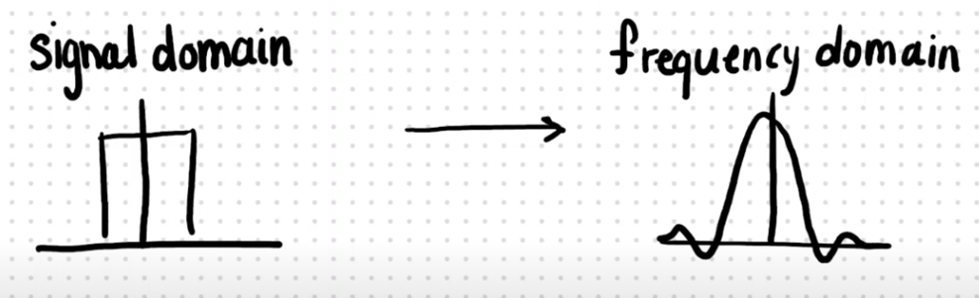
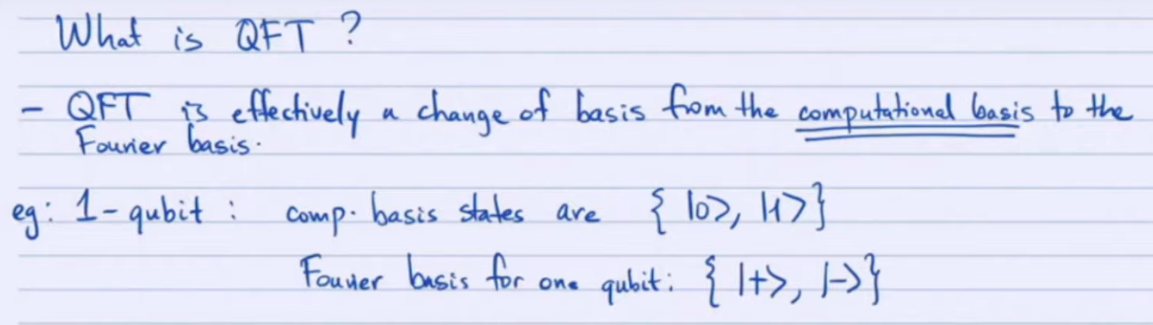


Quantum Algorithms
Quantum Fourier Transform
Quantum Phase Estimation
Quantum phase estimation (QPE) is a fundamental algorithm in quantum computing. It allows us to estimate the unknown phase of a quantum state.
In QPE, the QFT helps us map the unknown phase information onto the amplitudes of the output state.
Properties of QFT:
Invertibility: The QFT is an invertible operation. There exists an Inverse Quantum Fourier Transform (IQFT) that undoes the effects of the QFT and brings the state back to the computational basis.
Periodicity: Applying the QFT twice results in the original state. (QFT followed by IQFT).
Estimate Phase angle theta of the eigenvalue

Slide 25


Slide 26
Quantum Computing Applications
Quantum Annealing
Gate-Based Quantum Computing
Analog Simulation
Topological Quantum Computing
Specialized for optimization problems.
Finds the lowest energy state of a quantum system.
Involves evolving a quantum system from an initial to a final Hamiltonian.
Utilizes quantum gates to manipulate qubits.
Allows for the execution of quantum circuits and quantum algorithms.
Represents quantum information in superposition states.
Model based on topological qubits.
Aims to achieve fault-tolerant quantum computing.
Relies on exotic particles like non-abelian anyons.
A quantum system directly models the behavior of another quantum system.
It's like having one quantum system mirror the actions of another for specialized simulations.

Slide 27


Quantum Computing Applications
Quantum Annealing
Specialized for optimization problems.
Finds the lowest energy state of a quantum system.
Involves evolving a quantum system from an initial to a final Hamiltonian.
Quantum Tunnelling Principle in Action

Slide 28
Quantum Computing Applications
Quantum Annealing
Specialized for optimization problems.
Finds the lowest energy state of a quantum system.
Involves evolving a quantum system from an initial to a final Hamiltonian.
Route Optimization: To find the most efficient route from the starting to the target destination.
Portfolio Optimization: Optimization involves selecting the right mix of assets to maximize returns while minimizing risk.
Energy Optimization: Improves the efficiency of energy consumption in various domains, such as power grids, buildings, and renewable energy systems.
Machine Learning : To optimize hyperparameters in deep learning models or explore feature spaces efficiently.

Slide 29
Quantum Computing Applications
Cryptography: Quantum-safe encryption.
Drug Discovery: Accelerated drug development.
Material Science: Innovative materials design.
Optimization: Complex problem solving.
Machine Learning: Enhanced AI capabilities.
Climate Modelling: Precise climate predictions.
Financial Analysis: Risk assessment advancement.
Gate-Based Quantum Computing
Utilizes quantum gates to manipulate qubits.
Represents quantum information in superposition states.
Allows for the execution of quantum circuits and quantum algorithms.
Qubit represents
the encoded Classical
Information to Quantum
States.
Quantum Circuits
Composed of
Quantum Gates.

Slide 30


Quantum Computing Applications
Drug Discovery: Quantum simulation accelerates the development of new pharmaceuticals.
Materials Engineering : Tailoring materials with unique properties for diverse applications.
Sustainable Agriculture : Understanding ammonia production for more efficient fertilizer synthesis.
Analog Simulation
A quantum system directly models the behavior of another quantum system.
It's like having one quantum system mirror the actions of another for specialized simulations.
Haber Bosch-process
Bacteria + molybdenum nitrogenase

Slide 31
Quantum Computing Applications
Primarily a theoretical model getting shape in recent times.
In 2025 Microsoft claimed creating Majorana 1 – Topological qubit chip.
Robust against errors due to noisy environment
Fault tolerant computation.
Topological Quantum Computing
Model based on topological qubits.
Aims to achieve fault-tolerant quantum computing.
Relies on exotic particles like non-abelian anyons.
Notes:
In 2016 noble prize

Slide 32


Optimization
Total Nodes: N= 6 spots.
Total possible Combinations : (N-1) ! = (6-1)! = 5! = 5*4*3*2*1 = 120.

Slide 33



Optimization
What if there are at least 20 spots in a city to visit?
N= 20, Possible Combinations = 19! = 121,645,100,408,832,000.
Imagine, if N= 100
Possible Combinations = 99! = ${\text{9.332622}\text{×}\text{10}}^{155}$
Classical Algorithms
This Time Complexity is Non-Polynomial
N increases, the number of possible solutions (permutations) explodes exponentially. The time complexity moves from Polynomial to Non- Polynomial.

Slide 34

Optimization: Intractable Problems – Still Exist!!
Job Shop Scheduling
Resource Allocation
Vehicle Routing
Network Design
Protein Folding
Source: Optimization Applications as Quantum Performance Benchmarks, Quantum Economic Development Consortium (QED-C)

Slide 35
Quantum Optimization
Map the QUBO to Hamiltonian
Quantum Annealing
Option 1
Problem Formulation
Construct QUBO
Measurement
Iteration and Refinement
Map the QUBO to Qubit
Gate based Algorithm like VQE and QAOA
Integer Linear Programming
Quadratic Unconstrained Binary Optimization
Option 2
Result
Encoding
Solvers In Gate based Solver the Hamiltonian conversions happen

Slide 36

Quantum Optimization
Quantum Annealing
Quantum annealing is a quantum computing approach designed for solving optimization problems.
It leverages quantum effects to explore solution spaces efficiently and find optimal solutions.
Principle of Annealing:
Inspired by classical annealing in metallurgy, quantum annealing gradually evolves a quantum system from a state with high energy to a state with low energy, mimicking the process of cooling a physical system.
The goal is to reach the ground state (lowest energy state) of the system, which corresponds to the optimal solution of the optimization problem.
Notes:
Quadratic: QUBO represents the objective function and constraints of an optimization problem using quadratic polynomials. This means that each term in the function involves the product of two variables (binary decision variables) and possibly a constant coefficient.
Unconstrained: Unlike some other optimization formulations, such as integer linear programming (ILP), QUBO does not have explicit constraints. Instead, any constraints are implicitly incorporated into the objective function through penalty terms.
Binary: QUBO problems deal with binary decision variables, meaning each variable can take on one of two values: 0 or 1. These binary variables represent the choices or decisions being made in the optimization problem.

Slide 37


Quantum Optimization
Key Features of Quantum Annealing:
Exploration of Solution Space: Quantum annealing explores multiple potential solutions simultaneously, allowing for the exploration of complex solution spaces.
Escape from Local Minima: By leveraging quantum tunneling effects, annealing can escape local minima and converge towards the global minimum of the objective function.
Stochastic Nature: Annealing is inherently stochastic, meaning that the final solution may vary between different runs of the algorithm.
Adiabatic theorem
Slowly evolve the system to stay close to the ground state
Quantum tunneling
Can propagate through energy barrier despite the deficiency of energy
Notes:
Quadratic: QUBO represents the objective function and constraints of an optimization problem using quadratic polynomials. This means that each term in the function involves the product of two variables (binary decision variables) and possibly a constant coefficient.
Unconstrained: Unlike some other optimization formulations, such as integer linear programming (ILP), QUBO does not have explicit constraints. Instead, any constraints are implicitly incorporated into the objective function through penalty terms.
Binary: QUBO problems deal with binary decision variables, meaning each variable can take on one of two values: 0 or 1. These binary variables represent the choices or decisions being made in the optimization problem.

Slide 38
Quantum Optimization
Gate Based Quantum Computing
Gate-based quantum computing follows the principles of quantum mechanics, where qubits exist in superposition and can be entangled to perform complex computations.
Appy transformations to qubits and enable the execution of quantum algorithms.
Key Components of Gate-Based Quantum Computing:
Qubits: The fundamental units of information in gate-based quantum computing.
Quantum Gates: Elementary operations that manipulate the quantum state of qubits. Examples include Pauli gates, Hadamard gates, CNOT gates, and more.
Quantum Circuits: Sequences of quantum gates applied to qubits to perform computations. They represent quantum algorithms and transformations in a graphical form.
Notes:
Quadratic: QUBO represents the objective function and constraints of an optimization problem using quadratic polynomials. This means that each term in the function involves the product of two variables (binary decision variables) and possibly a constant coefficient.
Unconstrained: Unlike some other optimization formulations, such as integer linear programming (ILP), QUBO does not have explicit constraints. Instead, any constraints are implicitly incorporated into the objective function through penalty terms.
Binary: QUBO problems deal with binary decision variables, meaning each variable can take on one of two values: 0 or 1. These binary variables represent the choices or decisions being made in the optimization problem.

Slide 39

Quantum Optimization
Gate Based Quantum Computing
Quantum Algorithms in Gate-Based Computing:
Variational Quantum Eigensolver (VQE): An algorithm for finding the ground state energy of quantum systems, applicable to problems in quantum chemistry and materials science.
Quantum Approximate Optimization Algorithm (QAOA): An algorithm for solving combinatorial optimization problems by preparing quantum states that encode candidate solutions.
Notes:
How it works:
Prepare an initial state: Set the qubits in a known starting state using specific gates.
Apply parameterized gates: Introduce gates with adjustable parameters into the circuit. These parameters essentially control the "recipe" for manipulating the qubits and exploring different solution possibilities.
Measure the state: Measure the qubits in the current circuit state and calculate the cost function based on the measurement results.
Optimize the parameters: Feed the cost function value to a classical optimizer (e.g., gradient descent algorithm). The optimizer updates the gate parameters to steer the circuit towards lower cost values, potentially leading to the optimal solution.
Repeat steps 2-4: Iterate and refine the parameters until the cost function converges to a minimum, indicating a good solution.
Strengths of VQE:
Solves problems intractable for classical computers: VQE leverages the inherent power of quantum states to explore vast solution spaces efficiently.
Works on NISQ devices: It doesn't require perfect quantum hardware, making it practical for current technology.
Adaptable to various problems: The quantum circuit and cost function can be tailored to different optimization tasks.
Limitations of VQE:
No guarantee of finding the optimal solution: It's a heuristic algorithm, meaning it finds "good" solutions but not necessarily the absolute best.
Sensitive to noisy hardware: Errors in the quantum device can affect the accuracy of the results.
Requires expertise in quantum algorithms and optimization: Setting up and running VQE can be complex.
Applications of VQE:
Quantum chemistry: Simulating molecules and chemical reactions.
Materials science: Discovering new materials with desired properties.
Finance: Optimizing portfolios and investments.
Machine learning: Developing more efficient and powerful algorithms.
Key Components of QAOA:
Quantum Circuit: QAOA uses a parameterized quantum circuit composed of layers of single-qubit rotations and entangling gates.
Cost Hamiltonian: QAOA encodes the objective function of the optimization problem into a cost Hamiltonian, which represents the energy landscape to be minimized.
Mixer Hamiltonian: QAOA incorporates a mixer Hamiltonian, which prepares superpositions of candidate solutions and facilitates exploration of the solution space.
Workflow of QAOA:
Initialize the quantum circuit with initial parameter values.
Apply alternating layers of single-qubit rotations and entangling gates to the qubits.
Measure the expectation value of the cost Hamiltonian to evaluate the objective function.
Classically optimize the parameters of the quantum circuit using optimization algorithms like gradient descent or Bayesian optimization.
Repeat the optimization process iteratively until convergence is achieved or a desired solution quality is obtained.

Slide 40
Quantum Optimization
Gate-Based Approaches (VQE, QAOA):
Use Case: Suitable for problems where the objective function can be decomposed into simpler quantum circuits that can be implemented on quantum computers.
Advantages: Gate-based algorithms allow for more flexibility and control over the quantum circuits, making them suitable for a wide range of optimization problems.
Applications: Variational Quantum Eigensolver (VQE) is used for solving problems in quantum chemistry and materials science, while Quantum Approximate Optimization Algorithm (QAOA) is often applied to combinatorial optimization problems like the TSP and Max-Cut.
Annealing (Quantum Annealing):
Use Case: Well-suited for optimization problems where the objective function has many local minima and classical optimization methods struggle to find the global minimum efficiently.
Advantages: Annealing explores the solution space by slowly evolving the quantum state towards the ground state of the Hamiltonian, which can effectively escape local minima.
Applications: Traveling Salesman Problem (TSP), graph partitioning, and optimization with complex energy landscapes.
Notes:
Quadratic: QUBO represents the objective function and constraints of an optimization problem using quadratic polynomials. This means that each term in the function involves the product of two variables (binary decision variables) and possibly a constant coefficient.
Unconstrained: Unlike some other optimization formulations, such as integer linear programming (ILP), QUBO does not have explicit constraints. Instead, any constraints are implicitly incorporated into the objective function through penalty terms.
Binary: QUBO problems deal with binary decision variables, meaning each variable can take on one of two values: 0 or 1. These binary variables represent the choices or decisions being made in the optimization problem.

Slide 41
To Solve this NP problems using Quantum
Quantum Optimization
Map the QUBO to Hamiltonian
Quantum Annealing
Option 1
Problem Formulation
Construct QUBO
Measurement
Iteration and Refinement
Map the QUBO to Hamiltonian then to Qubit
Gate based Algorithm like VQE and QAOA with ansatz
Integer Linear Programming
Quadratic Unconstrained Binary Optimization
Option 2
Result
Encoding

Slide 42





Quantum Optimization
Problem Formulation
Travelling Salesperson (TSP) Using Quantum Annealing
$$\sum_{j=0}^{N}{c_{ij}}x_{ij}+Constant$$
$$\sum_{i=0}^{N}{ }$$
$$Minimize$$
N is the total number of cities.
$c_{ij}$is the distance (or cost) between city i and city j.
$x_{ij}$is a binary decision variable indicating whether there is a connection (edge) between city i and city j.
​ $x_{ij}$=1 if the connection exists, and $x_{ij}$​=0 otherwise.

Slide 43
Quantum Optimization
Construct QUBO
Travelling Salesperson (TSP)
Quadratic: QUBO represents the objective function and constraints of an optimization problem using quadratic polynomials.
Unconstrained: QUBO does not have explicit constraints. Any constraints are implicitly incorporated into the objective function through penalty terms.
Binary: QUBO problems deal with binary decision variables, meaning each variable can take on one of two values: 0 or 1. These binary variables represent the choices or decisions being made in the optimization problem.
Why QUBO?
QUBO provides a standardized representation for expressing optimization problems as a quadratic function over binary variables.
Notes:
Quadratic: QUBO represents the objective function and constraints of an optimization problem using quadratic polynomials. This means that each term in the function involves the product of two variables (binary decision variables) and possibly a constant coefficient.
Unconstrained: Unlike some other optimization formulations, such as integer linear programming (ILP), QUBO does not have explicit constraints. Instead, any constraints are implicitly incorporated into the objective function through penalty terms.
Binary: QUBO problems deal with binary decision variables, meaning each variable can take on one of two values: 0 or 1. These binary variables represent the choices or decisions being made in the optimization problem.

Slide 44



Quantum Optimization
Construct QUBO
Travelling Salesperson (TSP)
Quadratic
Notes:
Quadratic: QUBO represents the objective function and constraints of an optimization problem using quadratic polynomials. This means that each term in the function involves the product of two variables (binary decision variables) and possibly a constant coefficient.
Unconstrained: Unlike some other optimization formulations, such as integer linear programming (ILP), QUBO does not have explicit constraints. Instead, any constraints are implicitly incorporated into the objective function through penalty terms.
Binary: QUBO problems deal with binary decision variables, meaning each variable can take on one of two values: 0 or 1. These binary variables represent the choices or decisions being made in the optimization problem.

Slide 45


Quantum Optimization
Map the QUBO to Hamiltonian then to Qubit
Travelling Salesperson (TSP)
The total energy of the system is given by the expectation value of this Hamiltonian. Minimizing this energy corresponds to finding the optimal solution to the QUBO problem.
This Hamiltonian terms are mapped to Qubits.
Notes:
Therefore, Q(xij)^2 is equivalent to Q(xij). Now, to convert xij to a qubit operator (specifically, a Pauli-Z operator), we use the transformation xij = (1 - Zij) / 2, where Zij is the Pauli-Z operator acting on the qubits representing xij. Rearranging this, we get Zij = 1 - 2xij. Thus, the term Q(xij) in the Hamiltonian becomes Q(1 - 2xij).

Slide 46
Quantum Optimization
Gate based Algorithm like VQE and QAOA with ansatz
Travelling Salesperson (TSP)
This is where the parameterized quantum circuit (ansatz) is designed.
Hardware-Efficient Ansatz: A common approach is to use a hardware-efficient ansatz, which consists of alternating layers of single-qubit rotations (e.g., Ry, Rz) and entangling gates (e.g., CNOT). The rotation angles are the variational parameters that will be optimized.
Problem-Specific Ansatz: For certain problems, you might design an ansatz that reflects the structure of the Hamiltonian. For example, if the Hamiltonian has specific symmetries, you can design an ansatz that preserves those symmetries.
Initial parameter selection.
Choosing Optimizer.
Setting thresholds if any.
Notes:
Quadratic: QUBO represents the objective function and constraints of an optimization problem using quadratic polynomials. This means that each term in the function involves the product of two variables (binary decision variables) and possibly a constant coefficient.
Unconstrained: Unlike some other optimization formulations, such as integer linear programming (ILP), QUBO does not have explicit constraints. Instead, any constraints are implicitly incorporated into the objective function through penalty terms.
Binary: QUBO problems deal with binary decision variables, meaning each variable can take on one of two values: 0 or 1. These binary variables represent the choices or decisions being made in the optimization problem.

Slide 47
Quantum Optimization
Measurement
Travelling Salesperson (TSP)
Measure the state of the qubits to obtain a sample configuration.
Extract the solution corresponding to the lowest energy configuration obtained from multiple runs or samples.
Post-processing and Solution Validation:
Analyze the results obtained from the quantum annealer and validate the solution against problem constraints.
Post-processing techniques may be applied to refine the solution or filter out unwanted configurations.
Notes:
Quadratic: QUBO represents the objective function and constraints of an optimization problem using quadratic polynomials. This means that each term in the function involves the product of two variables (binary decision variables) and possibly a constant coefficient.
Unconstrained: Unlike some other optimization formulations, such as integer linear programming (ILP), QUBO does not have explicit constraints. Instead, any constraints are implicitly incorporated into the objective function through penalty terms.
Binary: QUBO problems deal with binary decision variables, meaning each variable can take on one of two values: 0 or 1. These binary variables represent the choices or decisions being made in the optimization problem.

Slide 48
Quantum Optimization
Iteration and Refinement
Travelling Salesperson (TSP)
Evaluate the performance of the solver based on solution quality, computation time, and scalability to larger problem instances.
Compare the solver results with classical optimization methods to assess effectiveness and efficiency.
Iterative Refinement :
Iteratively adjust parameters or problem encoding, or ansatz based on feedback from performance evaluation to improve solution quality or convergence.
Notes:
Quadratic: QUBO represents the objective function and constraints of an optimization problem using quadratic polynomials. This means that each term in the function involves the product of two variables (binary decision variables) and possibly a constant coefficient.
Unconstrained: Unlike some other optimization formulations, such as integer linear programming (ILP), QUBO does not have explicit constraints. Instead, any constraints are implicitly incorporated into the objective function through penalty terms.
Binary: QUBO problems deal with binary decision variables, meaning each variable can take on one of two values: 0 or 1. These binary variables represent the choices or decisions being made in the optimization problem.

Slide 49
Thank You

